Slide 1
The Neural Tangent Kernel
Duncan Kirby
January 24, 2020

Slide 2
Perplexing behaviour of neural nets
Neural networks are grossly overparameterized and yet in many applications they generalize better than any other models to unseen data
If you watch the weights and biases of a neural network during its training, you will see that the values hardly change at all over the course of training
This is more and more true as the size of the layers gets larger

Slide 3
Goal: offer reasons for this strange behaviour

Slide 4

Linear Approximation of a FFNN
We can linearly approximate our neural net near its initial weights
$$f\left(x,w\right)≈f\left(x,w_{0}\right)+∇_{w}f{\left(x,w\right)}^{T}(w−w_{0})$$

Slide 5
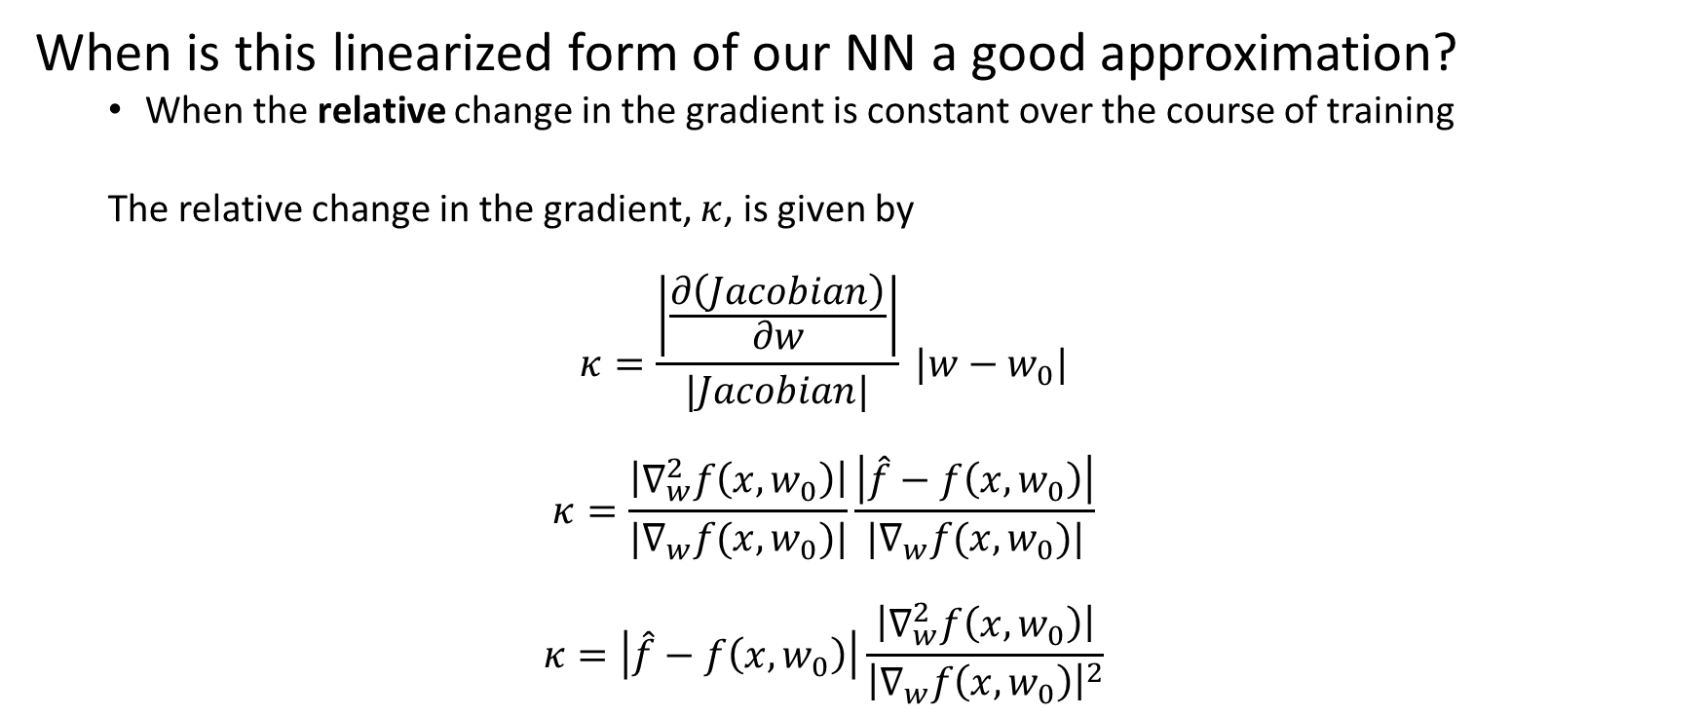
Linear Approximation of a FFNN
When is this linearized form of our NN a good approximation?
When the relative change in the gradient is constant over the course of training
The relative change in the gradient, $κ$, is given by
$$κ=\frac{\left|\frac{∂\left(Jacobian\right)}{∂w}\right|}{|Jacobian|} |w−w_{0}|$$
$$κ=\frac{\left|∇_{w}^{2}f\left(x,w_{0}\right)\right|}{|∇_{w}f(x,w_{0})|}\frac{\left|\hat{f}−f\left(x,w_{0}\right)\right|}{|∇_{w}f(x,w_{0})|}$$
$$κ=\left|\hat{f}−f\left(x,w_{0}\right)\right|\frac{\left|∇_{w}^{2}f\left(x,w_{0}\right)\right|}{{\left|∇_{w}f\left(x,w_{0}\right)\right|}^{2}}$$

Slide 6
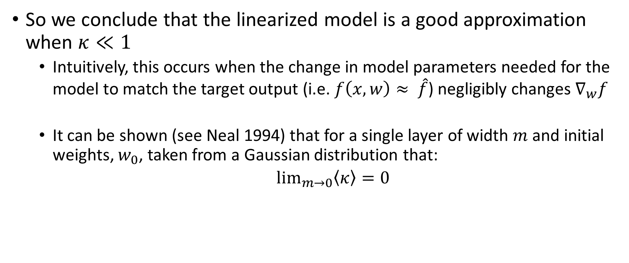
Linear Approximation of a FFNN
So we conclude that the linearized model is a good approximation when $κ≪1$
Intuitively, this occurs when the change in model parameters needed for the model to match the target output (i.e. $f\left(x,w\right)≈ \hat{f}$) negligibly changes $∇_{w}f$
It can be shown (see Neal 1994) that for a single layer of width $m$ and initial weights, $w_{0}$, taken from a Gaussian distribution that:
$\lim_{m→0}\left\langle κ\right\rangle =0$

Slide 7
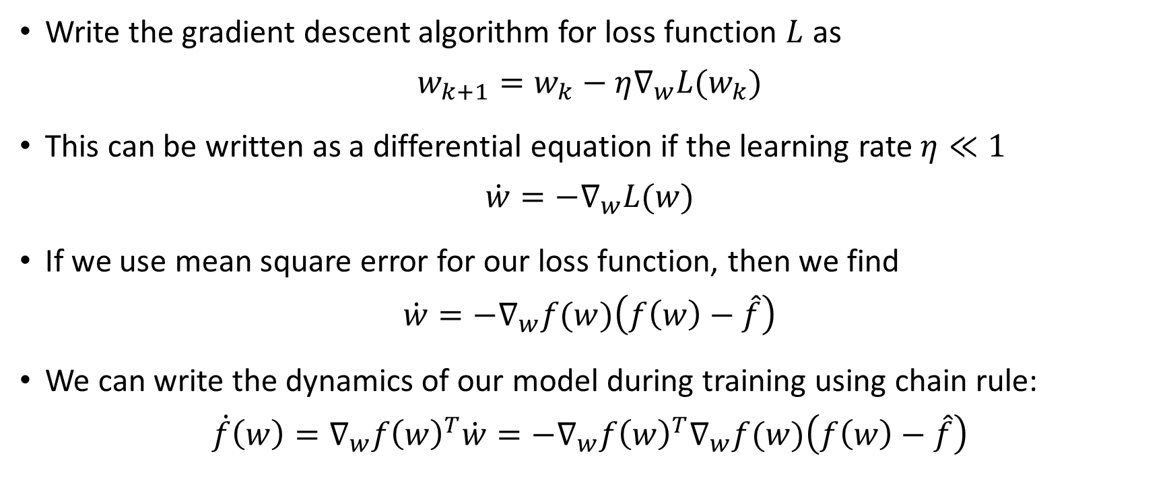
Gradient Flow
Write the gradient descent algorithm for loss function $L$ as
$$w_{k+1}=w_{k}−η∇_{w}L(w_{k})$$
This can be written as a differential equation if the learning rate $η≪1$
$$\dot{w}=−∇_{w}L(w)$$
If we use mean square error for our loss function, then we find
$$\dot{w}=−∇_{w}f(w)\left(f\left(w\right)−\hat{f}\right)$$
We can write the dynamics of our model during training using chain rule:
$$\dot{f}\left(w\right)=∇_{w}f{\left(w\right)}^{T}\dot{w}=−∇_{w}f{\left(w\right)}^{T}∇_{w}f(w)\left(f\left(w\right)−\hat{f}\right)$$

Slide 8
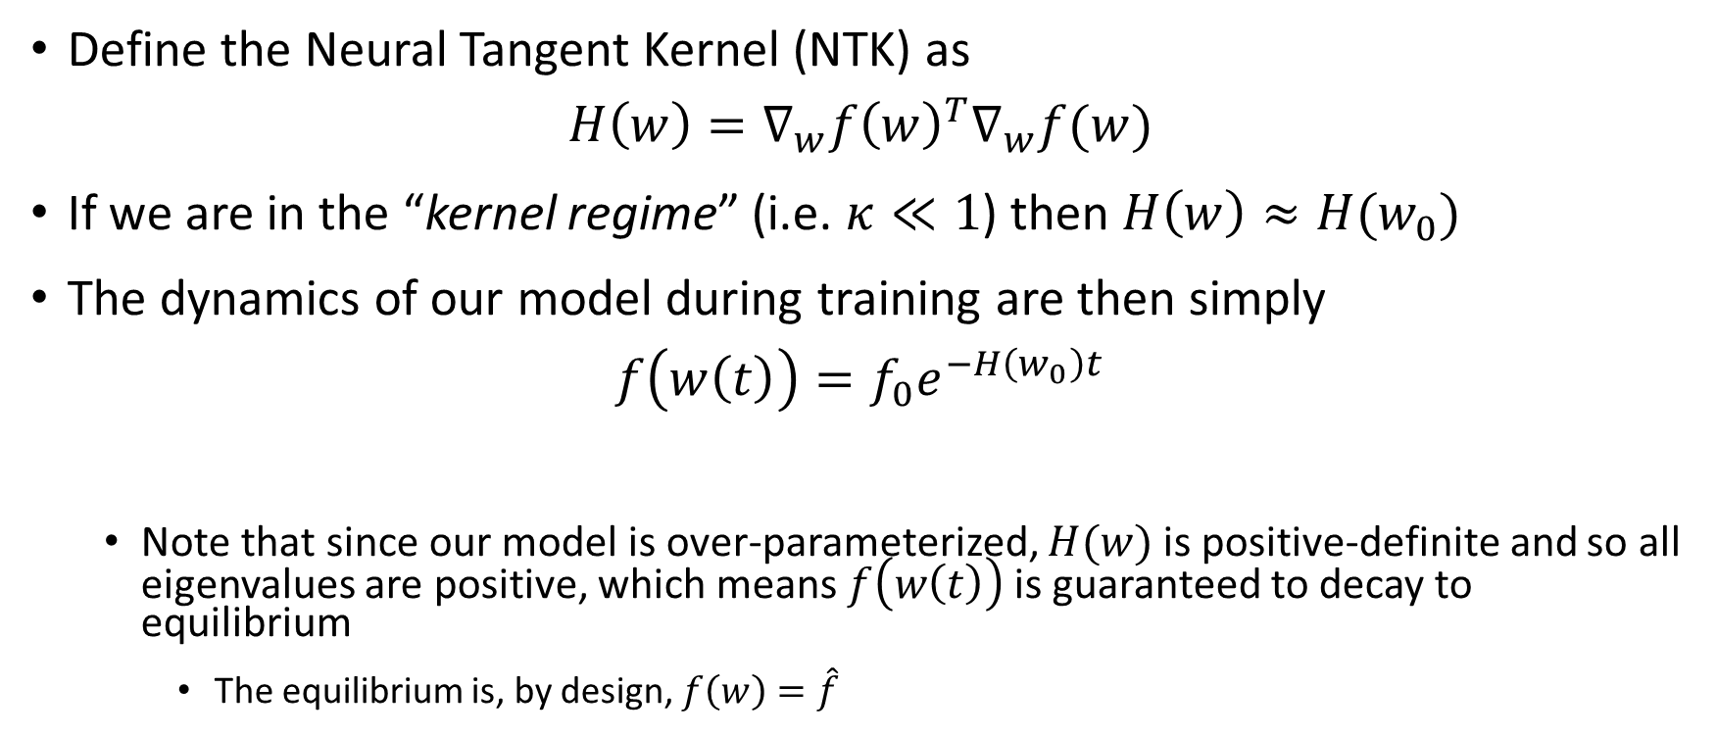
The Neural Tangent Kernel
Define the Neural Tangent Kernel (NTK) as
$$H\left(w\right)=∇_{w}f{\left(w\right)}^{T}∇_{w}f(w)$$
If we are in the “kernel regime” (i.e. $κ≪1$) then $H\left(w\right)≈H(w_{0})$
The dynamics of our model during training are then simply
$$f\left(w\left(t\right)\right)=f_{0}e^{−H\left(w_{0}\right)t}$$
Note that since our model is over-parameterized, $H(w)$ is positive-definite and so all eigenvalues are positive, which means $f\left(w\left(t\right)\right)$ is guaranteed to decay to equilibrium
The equilibrium is, by design, $f\left(w\right)=\hat{f}$

Slide 9
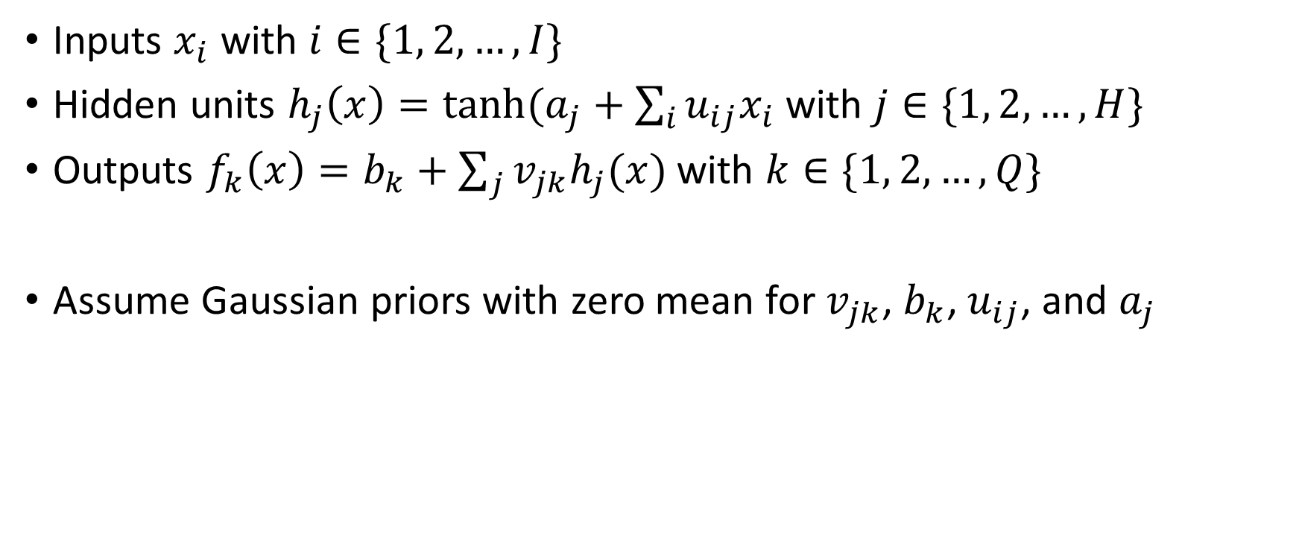
What is the function space our NN trains in?
Inputs $x_{i}$ with $i∈\{1, 2, …,I\}$
Hidden units $h_{j}\left(x\right)=tanh⁡(a_{j}+\sum_{i}{u_{ij}x_{i}}$ with $j∈\{1, 2, …,H\}$
Outputs $f_{k}\left(x\right)=b_{k}+\sum_{j}{v_{jk}h_{j}(x)}$ with $k∈\{1, 2, …,Q\}$
Assume Gaussian priors with zero mean for $v_{jk}$, $b_{k}$, $u_{ij}$, and $a_{j}$

Slide 10
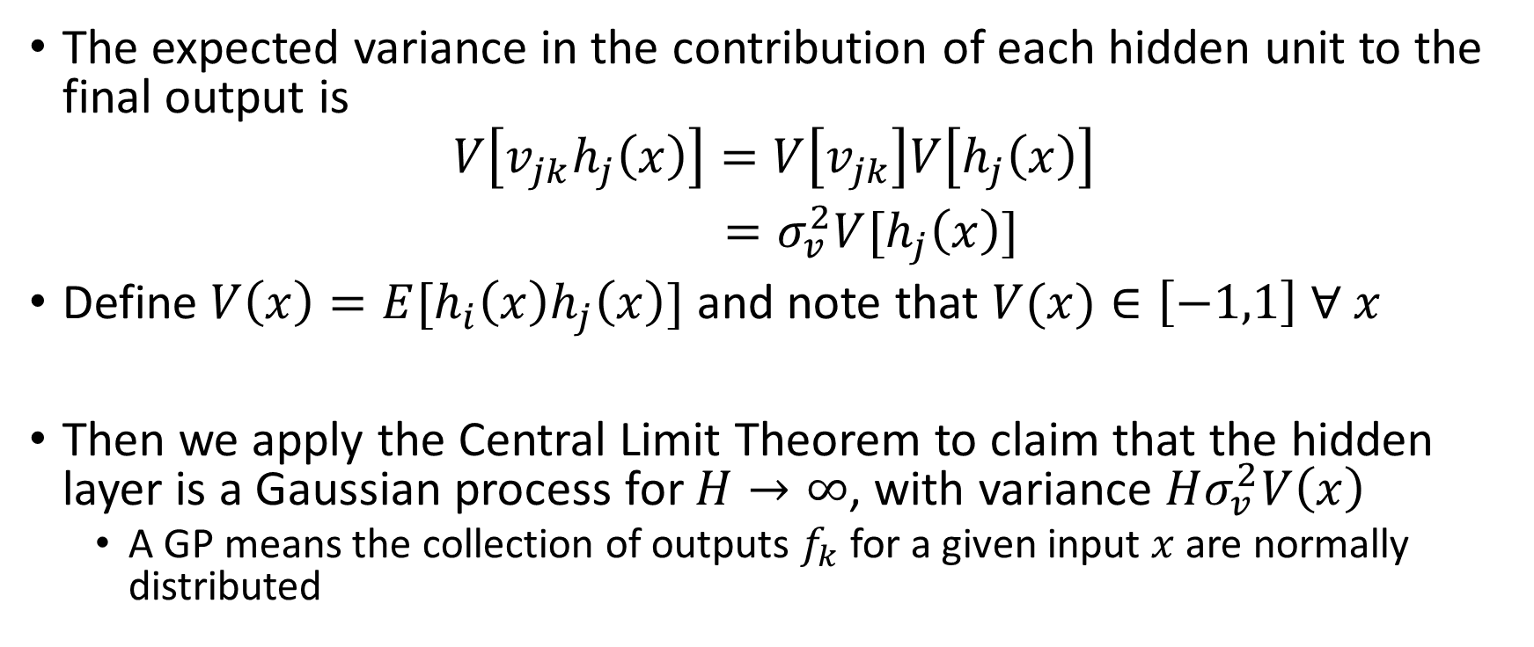
What is the function space our NN trains in?
The expected variance in the contribution of each hidden unit to the final output is
$$V\left[v_{jk}h_{j}\left(x\right)\right]=V\left[v_{jk}\right]V\left[h_{j}\left(x\right)\right]$$
$=σ_{v}^{2}V[h_{j}\left(x\right)]$
Define $V\left(x\right)=E[h_{i}\left(x\right)h_{j}\left(x\right)]$ and note that $V(x)∈\left[−1,1\right] ∀ x$
Then we apply the Central Limit Theorem to claim that the hidden layer is a Gaussian process for $H→∞$, with variance $Hσ_{v}^{2}V\left(x\right)$
A GP means the collection of outputs $f_{k}$ for a given input $x$ are normally distributed

Slide 11
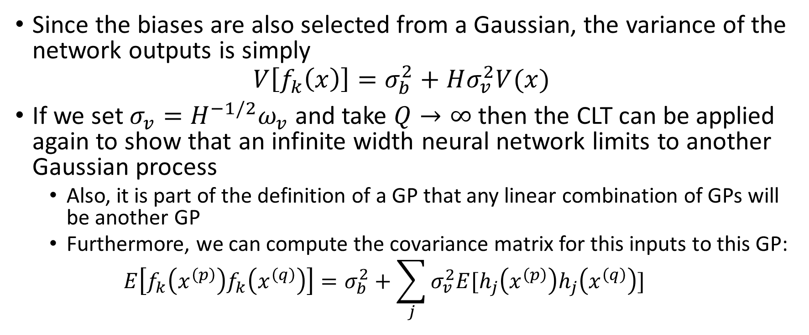
What is the function space our NN trains in?
Since the biases are also selected from a Gaussian, the variance of the network outputs is simply
$$V\left[f_{k}\left(x\right)\right]=σ_{b}^{2}+Hσ_{v}^{2}V(x)$$
If we set $σ_{v}=H^{−1/2}ω_{v}$ and take $Q→∞$ then the CLT can be applied again to show that an infinite width neural network limits to another Gaussian process
Also, it is part of the definition of a GP that any linear combination of GPs will be another GP
Furthermore, we can compute the covariance matrix for this inputs to this GP:
$$E\left[f_{k}\left(x^{\left(p\right)}\right)f_{k}\left(x^{\left(q\right)}\right)\right]=σ_{b}^{2}+\sum_{j}{σ_{v}^{2}E[h_{j}\left(x^{\left(p\right)}\right)h_{j}\left(x^{\left(q\right)}\right)]}$$

Slide 12
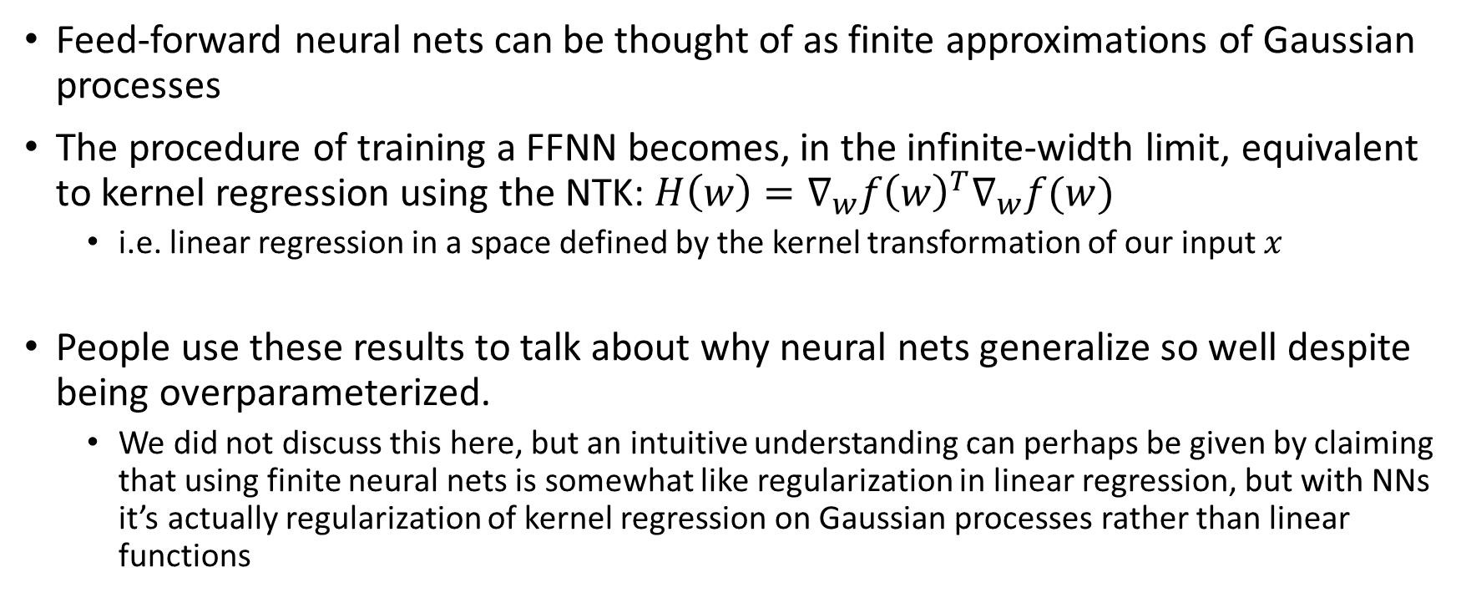
Conclusion
Feed-forward neural nets can be thought of as finite approximations of Gaussian processes
The procedure of training a FFNN becomes, in the infinite-width limit, equivalent to kernel regression using the NTK: $H\left(w\right)=∇_{w}f{\left(w\right)}^{T}∇_{w}f(w)$
i.e. linear regression in a space defined by the kernel transformation of our input $x$
People use these results to talk about why neural nets generalize so well despite being overparameterized.
We did not discuss this here, but an intuitive understanding can perhaps be given by claiming that using finite neural nets is somewhat like regularization in linear regression, but with NNs it’s actually regularization of kernel regression on Gaussian processes rather than linear functions

Slide 13
Resources
Infinite width NNs
Neal RM (1994) Bayesian Learning for Neural Networks.
Lee J, et al. (2018) Deep neural networks as Gaussian processes. 6th Int Conf Learn Represent ICLR 2018 - Conf Track Proc.
The NTK
https://rajatvd.github.io/NTK/
Jacot A, Gabriel F, Hongler C (2018) Neural tangent kernel: Convergence and generalization in neural networks. Adv Neural Inf Process Syst 2018-Decem(5):8571–8580.
Arora S, et al. (2019) On Exact Computation with an Infinitely Wide Neural Net. (NeurIPS). Available at: http://arxiv.org/abs/1904.11955.

